Slide 1
A Project Update on
Mystery Solver Application
By Group 8 CSE440 (Section-1)

Slide 2
Work Distribution
Serial No. | Student ID | Student Name | Completed Tasks
1. | 2212628042 | Naima Zaman Roshni | Bayesian Network Model & Bayesian Inference Devlopment
2. | 2131724642 | Sadia Islam Mou | Mystery Scenario Load, Presentation Slide, Update Project Report Writing
3. | 1821113042 | Tarif Shahriar | Main Python File
4. | 1931527042 | Myesha Tabassum | Case load

Slide 3
Problem Statement & Solution
Problem Statement
Crime scenes often have multiple suspects and incomplete evidence Human struggles to calculate probabilities under uncertainty
Proposed Solution
Models the mystery case with suspects and evidence as nodes in a Bayesian Network.
Updates beliefs as new evidence is entered.
Outputs the most likely guilty suspect with an explanation

Slide 4
Key Features
Custom Bayesian Network per case
Multiple evidence types as inputs
Real-time inference using pgmpy
Scenario loader for plug-and-play mystery files
Streamlit UI with suspect images, dropdowns, and result explanation
Graphviz-based network visualization

Slide 5
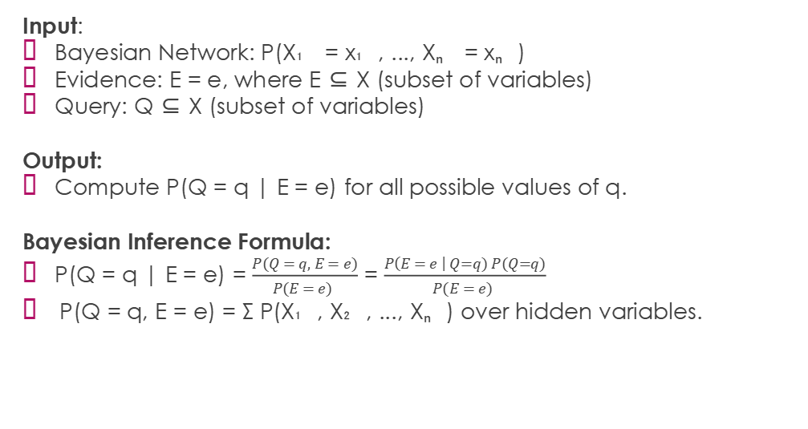
Baysian Network & Inference
Input:
Bayesian Network: P(X₁ = x₁, ..., Xₙ = xₙ)
Evidence: E = e, where E ⊆ X (subset of variables)
Query: Q ⊆ X (subset of variables)
Output:
Compute P(Q = q | E = e) for all possible values of q.
Bayesian Inference Formula:
P(Q = q | E = e) = $\frac{P(Q = q, E = e)}{P(E = e) }$ = $\frac{P\left(E = e \right| Q=q) P(Q=q)}{P(E = e) }$
P(Q = q, E = e) = Σ P(X₁, X₂, ..., Xₙ) over hidden variables.

Slide 6
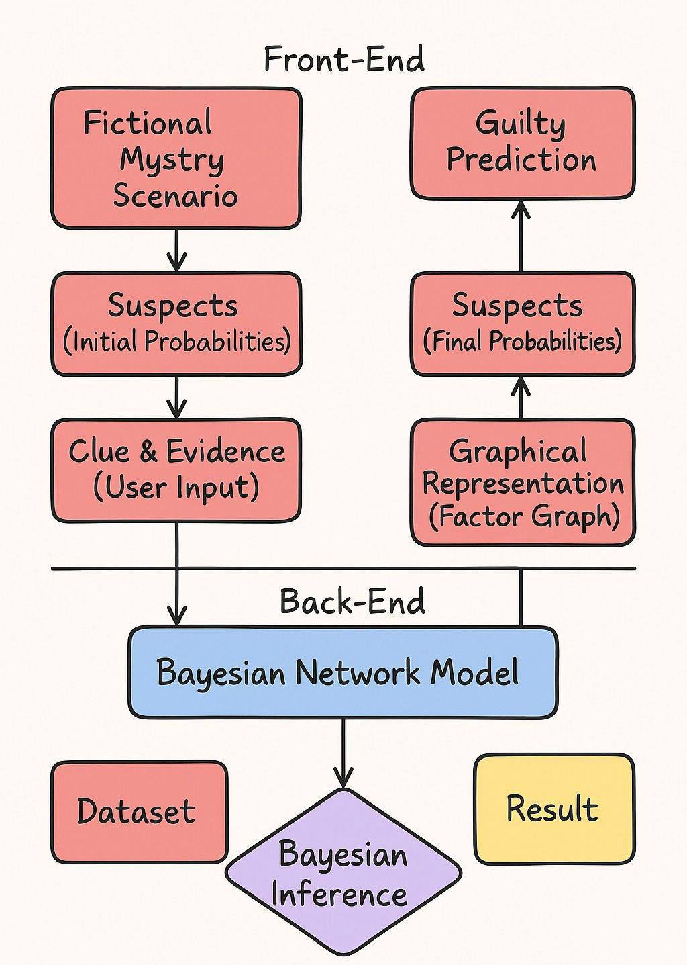
Project Diagram

Slide 7
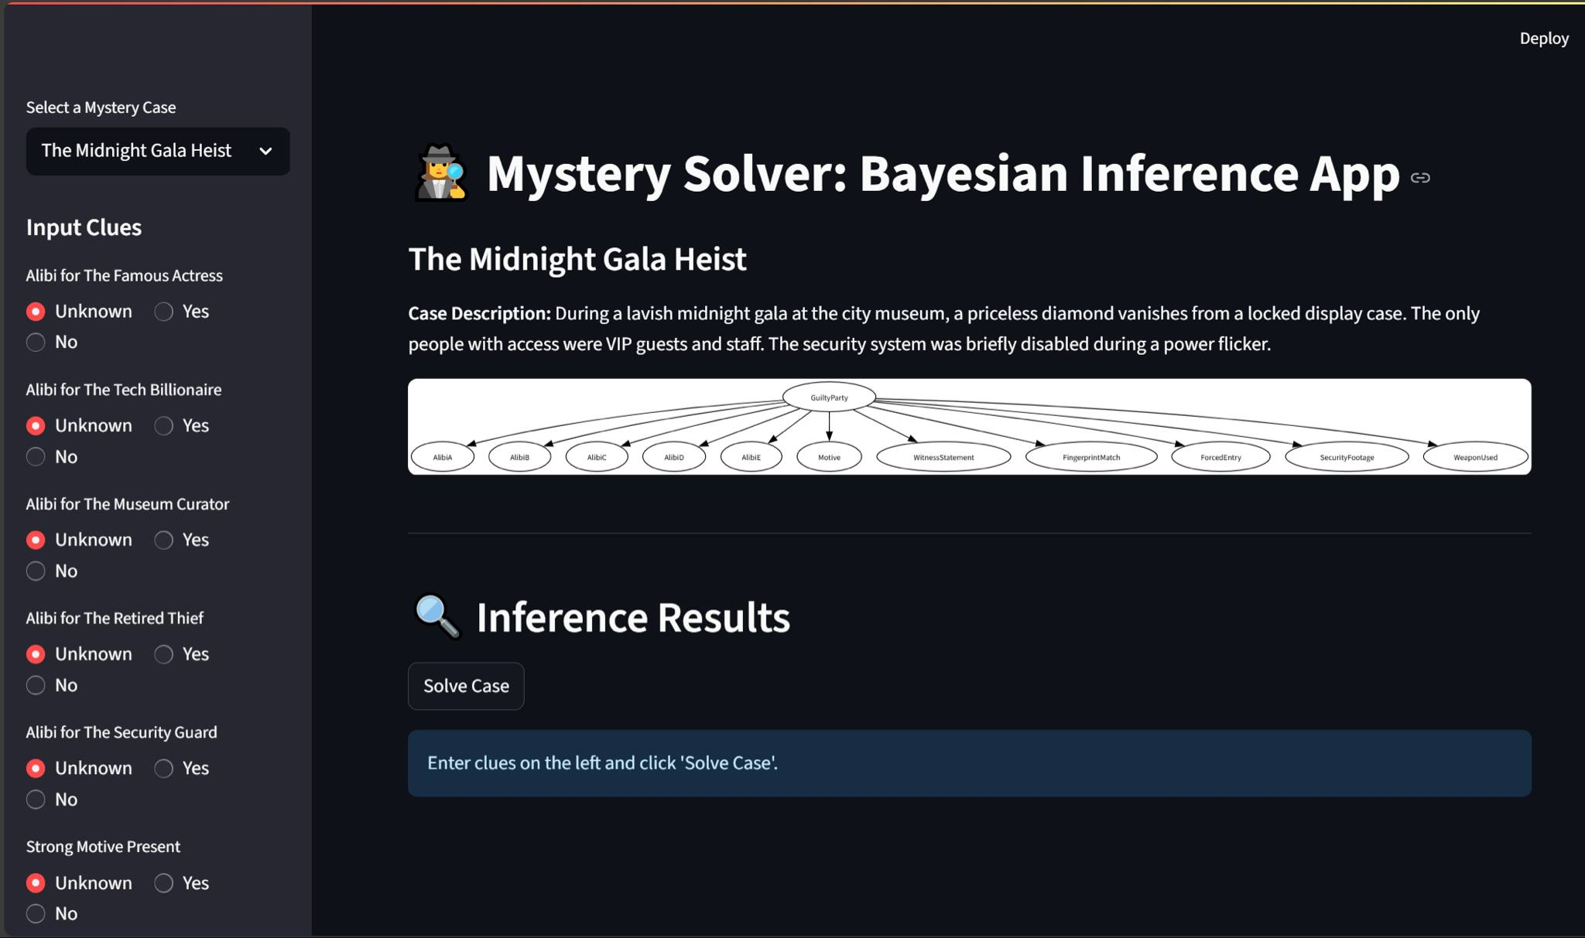
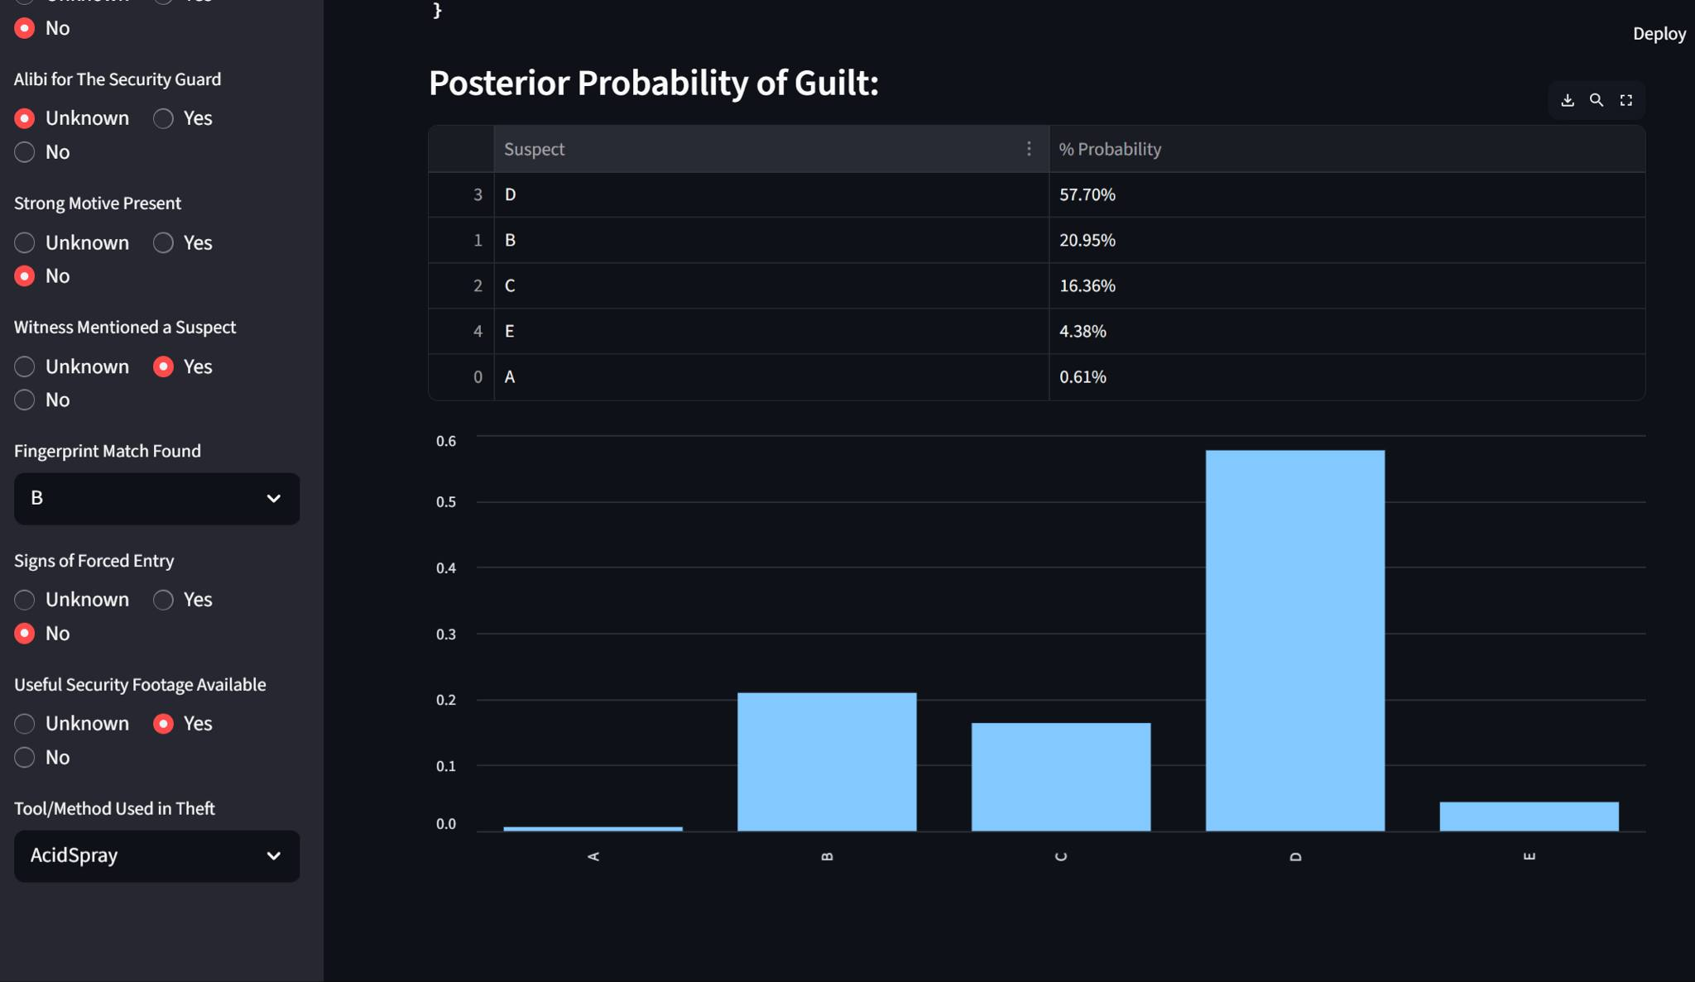
Baysian Network Model Prototyping
Figure 1: Input
Figure 2: Output

Slide 8
Technology Stack
Layer | Technology
Frontend | Streamlit (Python)
Backend Logic | pgmpy (Bayesian Model)
Visualization | Graphviz
Data Management | JSON-based scenarios
Environment Mgmt | Conda, pip

Slide 9

scenario_loader.py
This module loads mystery case data from JSON files

Slide 10
Progress & Achievements
Completed modular architecture (main.py,scenario_loader.py, mystery_solver.py)
Implemented two fully functional mystery cases
Supports natural language explanation of inference
Visual UI working in Streamlit
Easy to extend with new mystery scenarios

Slide 11
Future Work
Add user-generated cases upload support
Integrate LLM or GPT-style explanation for reasoning
Add auto-suggest clues based on entropy
Add posterior probability visualization for each suspect
Deploy as web/mobile app

Slide 12
References
1. Stanford University, ”Bayesian Networks 1 - Inference — Stanford CS221: AI (Autumn 2019),” YouTube, Oct. 2019. [Online]. Available: https://youtu.be/U23yuPEACG0?si=ifV8mUMcd-86-rmL. [Accessed: 24-Feb-2025].
2. P. Bercker, ”Who is guilty? Another look at a puzzle with Bayesian networks,” Medium, [Online]. Available: https://medium.com/@pbercker/who-is-guilty-another-look-at-a-puzzle-with-bayesian-networks-d1d2369ac9ce. [Accessed: Feb. 24, 2025].
3. “Evidence in Context: Bayes’ Theorem and Investigations,” YouTube, [Online]. Available: https://youtu.be/EC6bf8JCpDQ?si=vzAoYaC-O6bckkdI. [Accessed: Feb. 24, 2025].
4. P. Blair and D. K. Rossmo, “Evidence in Context: Bayes’ Theorem and Investigations,” Police Quarterly, vol. 13, no. 2, pp. 123-135, 2010. [On-line]. Available: https://doi.org/10.1177/1098611110365686. [Accessed:Feb. 24, 2025].
5. D. K. Rossmo, “Using Bayesian Networks in Crime Inves-tigations,” Divaportal, [Online]. Available: https://www.divaportal.org/smash/get/diva2:1265471/FULLTEXT01.pdf. [Accessed: Feb. 24, 2025

